Slide 1
Design Thinking
Lesson 1

Slide 2
What is Design Thinking?
User Centered Design
A process of understanding people and designing for them
What might the steps be in this process?
How might this differ from a traditional business process?
What might this process be used for?

Slide 3

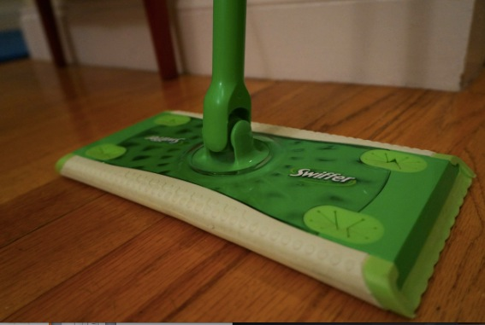
How would you Redesign a Mop?
Business Thinking
Design Thinking
{“spreadsheets & precedents”}
{“people & innovation”}
Compare existing mops
Observe people mopping
Maximize cost savings
Identify their pain points
Optimize logistics
Address these pain points
(p.s The Swiffer is a real example of a product designed by design firm Continuum!)

Slide 4
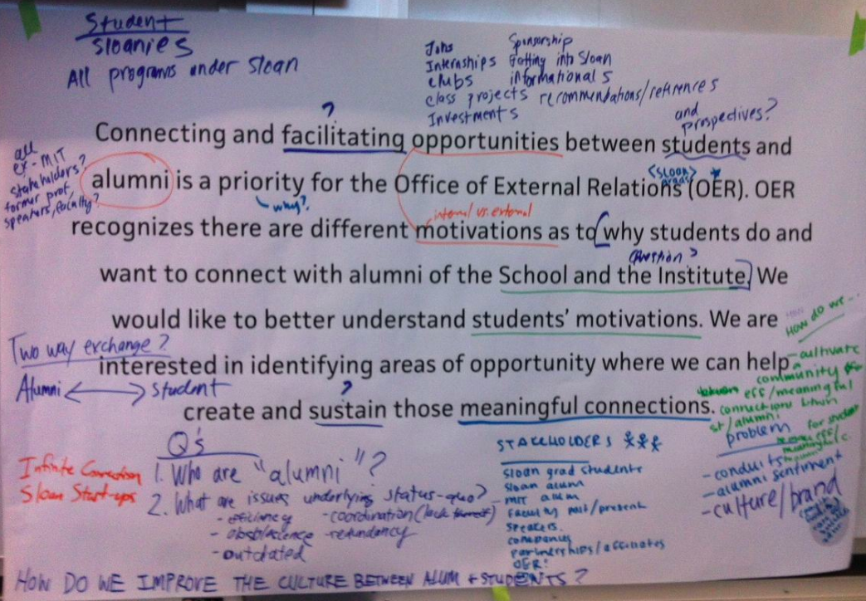
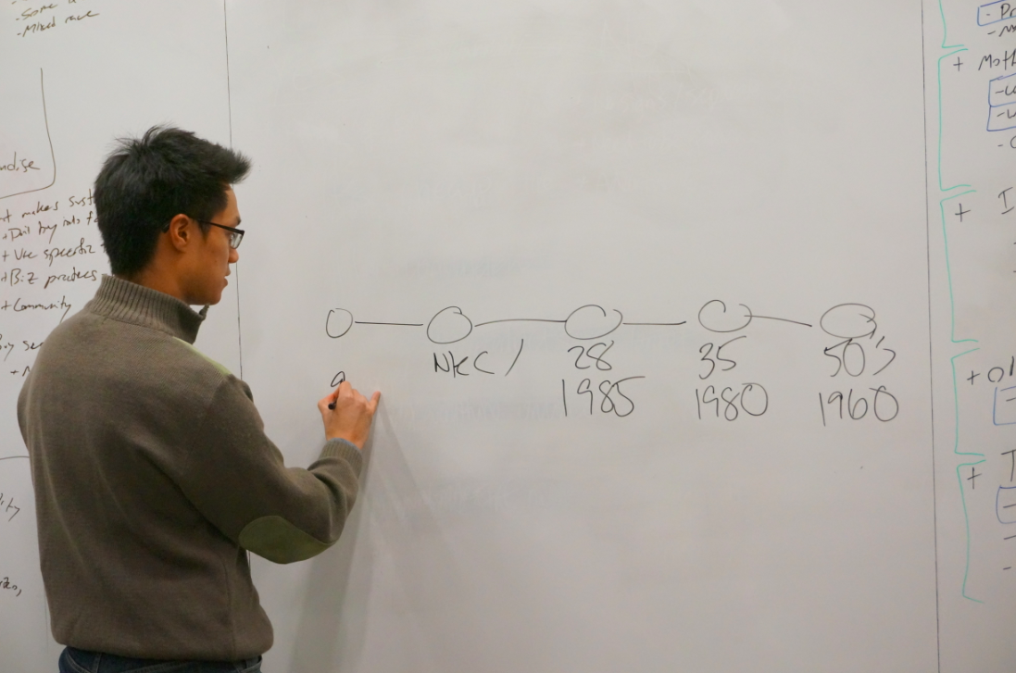
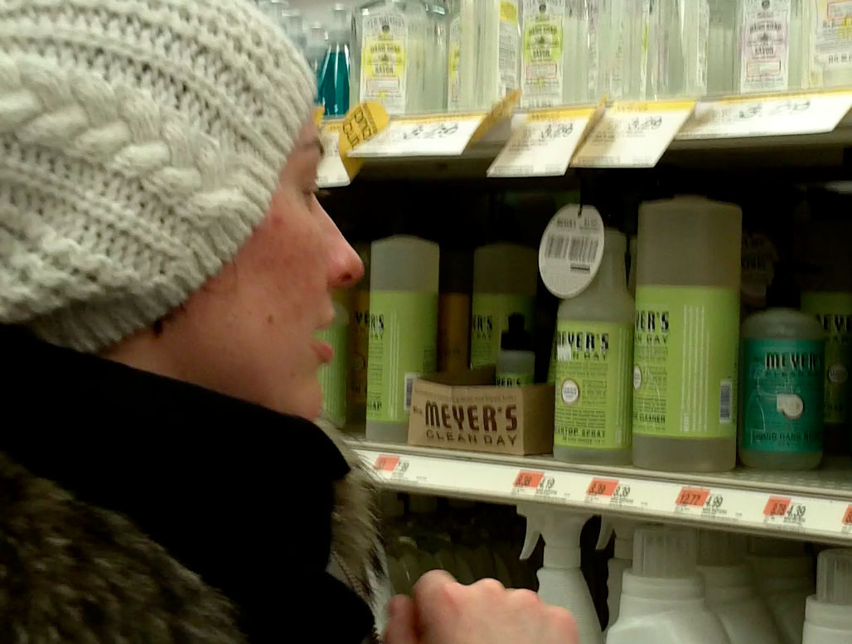
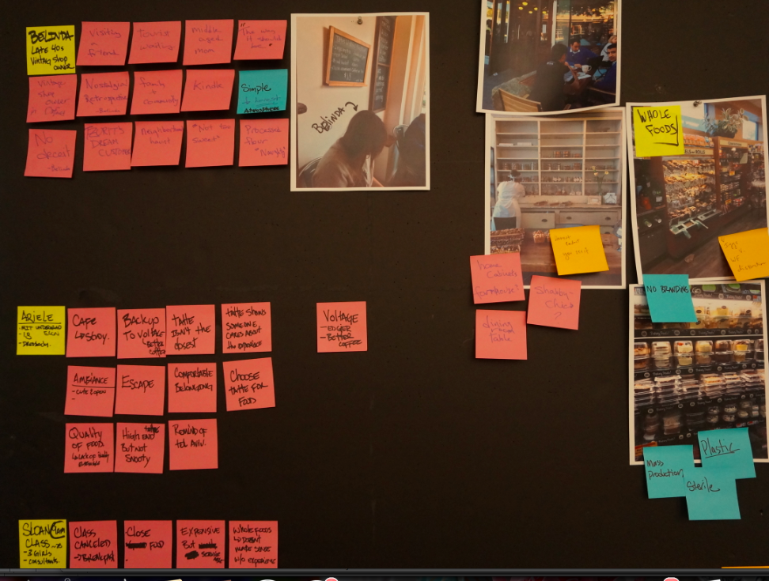
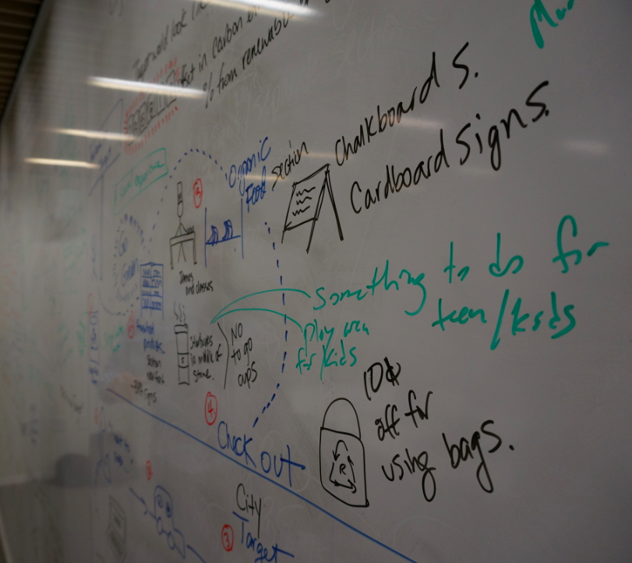
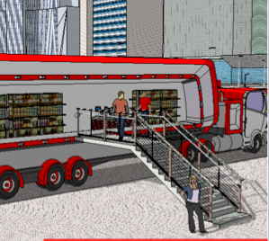
The User Centered Design Process
1.
Define
Problem Statement
2.
Determine
Stakeholders
3.
Observe/Interact;
Speak with Stakeholders
4.
Debrief and Generate
Help Me Statements
5.
Ideate to Address
these Pain Points
6.
Prototype, Test
in the Field, Iterate

Slide 5


Getting Rid of Cables: An Example
Background: You have been hired by electronic accessories company, Belkin, to apply design thinking to develop a new product.
Problem Statement: Our customers who are on-the-go hate dealing with device cables (laptops, tablets, phones, etc.). We want a solution to make it easier for customers to manage these cords.

Slide 6
Getting Rid of Cables: An Example
Step 1
Define the Problem Statement
Make the new statement broad enough to capture all opportunity areas
Given Problem Statement: Our customers who are on-the-go hate dealing with device cables (laptops, tablets, phones, etc.). We want a solution to make it easier for customers to manage these cords.
New Problem Statement:

Slide 7
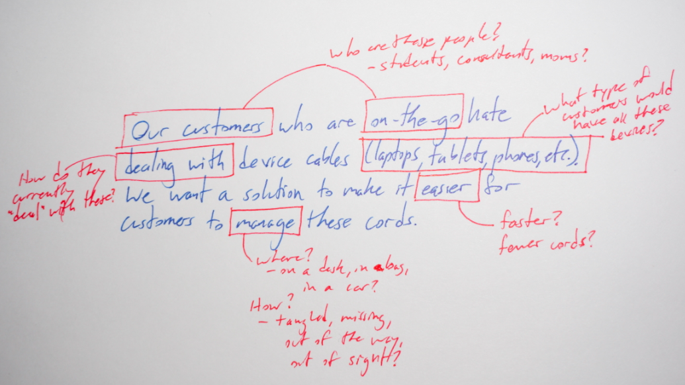
Getting Rid of Cables: An Example
Step 1
Define the Problem Statement
Make the new statement broad enough to capture all opportunity areas
“How can Belkin help on-the-go device users keep their devices easily accessible and ready when needed throughout the day.”

Slide 8
Getting Rid of Cables: An Example
Step 2
Determine Stakeholders
Begin to develop personas that encompass the pain points
Define stakeholders, a description/image of each, and their needs

Slide 9
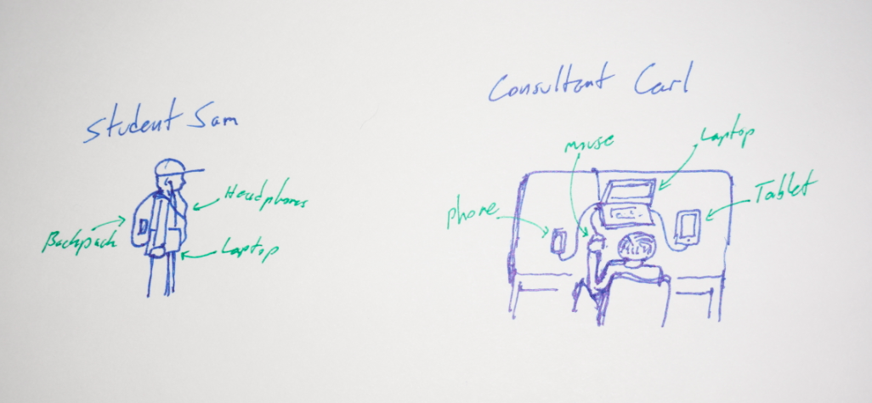
Getting Rid of Cables: An Example
Step 2
Determine Stakeholders
Begin to develop personas that encompass the pain points
Sam needs to manage his devices on-the-go, quickly swapping things in and out
Carl needs to efficiently set up his devices once he arrives at the hotel or office

Slide 10
For Lesson 2

Slide 11
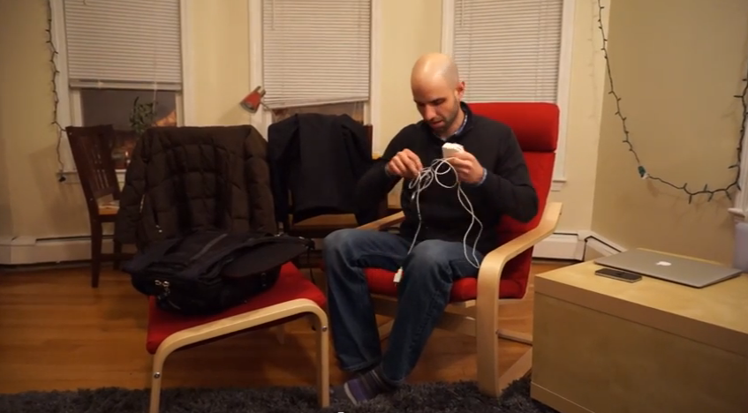
Getting Rid of Cables: An Example
Step 3
Observe/Interact; Speak with Stakeholders
Observe stakeholders and speak with them about their experience
Walk in their footsteps to experience their pain points firsthand
Watch clip: youtu.be/_MIt4q-gZno
What are the specific areas of frustration or inefficiencies?

Slide 12
Getting Rid of Cables: An Example
Step 4
Debrief and Generate Help Me Statements
Turn the identified pain points into “Help Me” statements so that you have concrete direction to begin generating ideas

